Slide 1


European Prescribing Exam
Preparing future medical doctors
in the European Union for
safe prescribing

Slide 2
Agenda
Background EuroPE⁺
The European Prescribing exam
The platform
The pilot
The future

Slide 3
Background (1/5)
Junior doctors write most (±70%) drug prescriptions in the
hospital (Dornan et al. 2009; Ryan et al. 2014 ; Ashcroft et al. 2015)
Junior doctors twice as likely to make a prescribing error
compared to consultants (Dornan et al. 2009; Ryan et al. 2014; Ashcroft et al. 2015)

Slide 4
Background (2/5)
Possible causes:
  High working load
  Relying too much on the pharmacist
  Inadequat support from supervisor
  Etc…
  Insufficient knowledge and skills
EACPT Education Working intiated multiple research projects

Slide 5
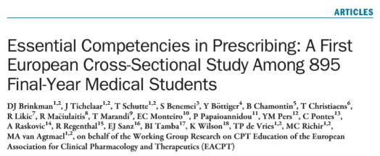
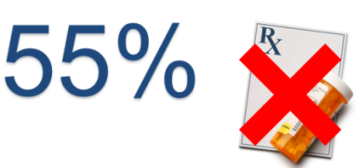


Background (3/5)
45%
‘Never had written out
a prescription’

Slide 6
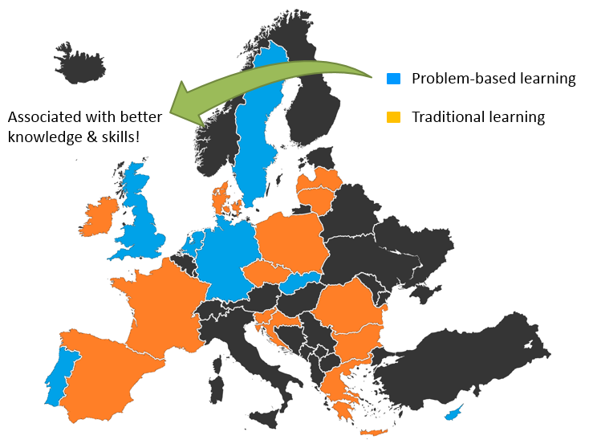
Background (4/5)

Slide 7

Background (5/5)
www.prescribingeducation.eu

Slide 8
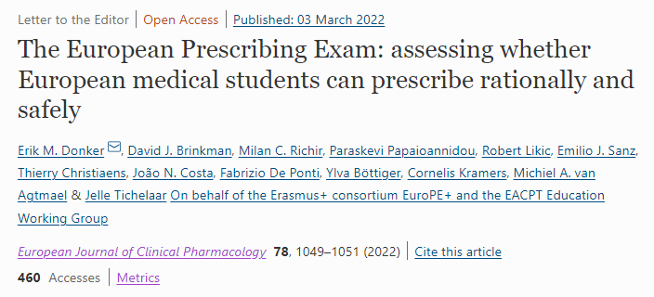

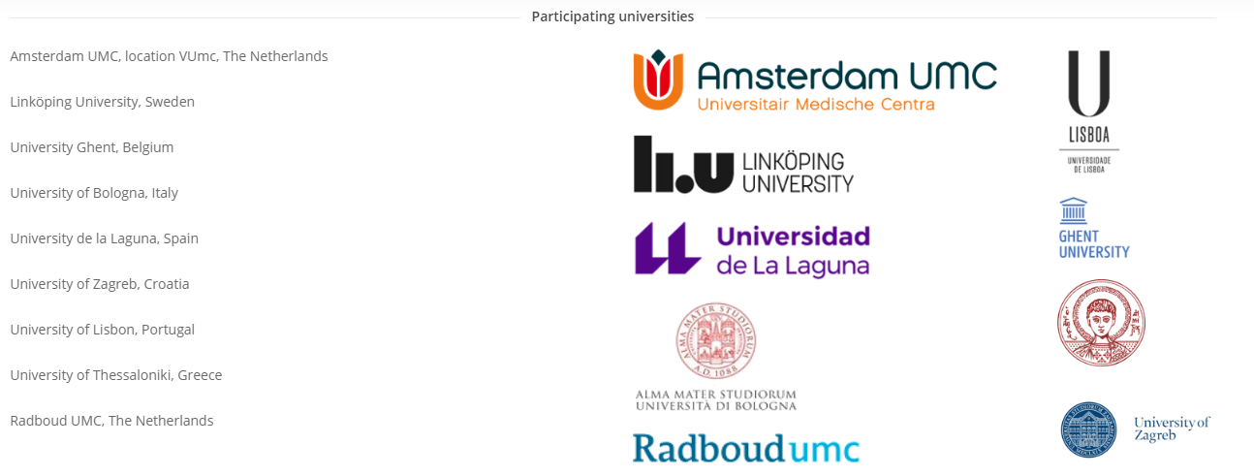
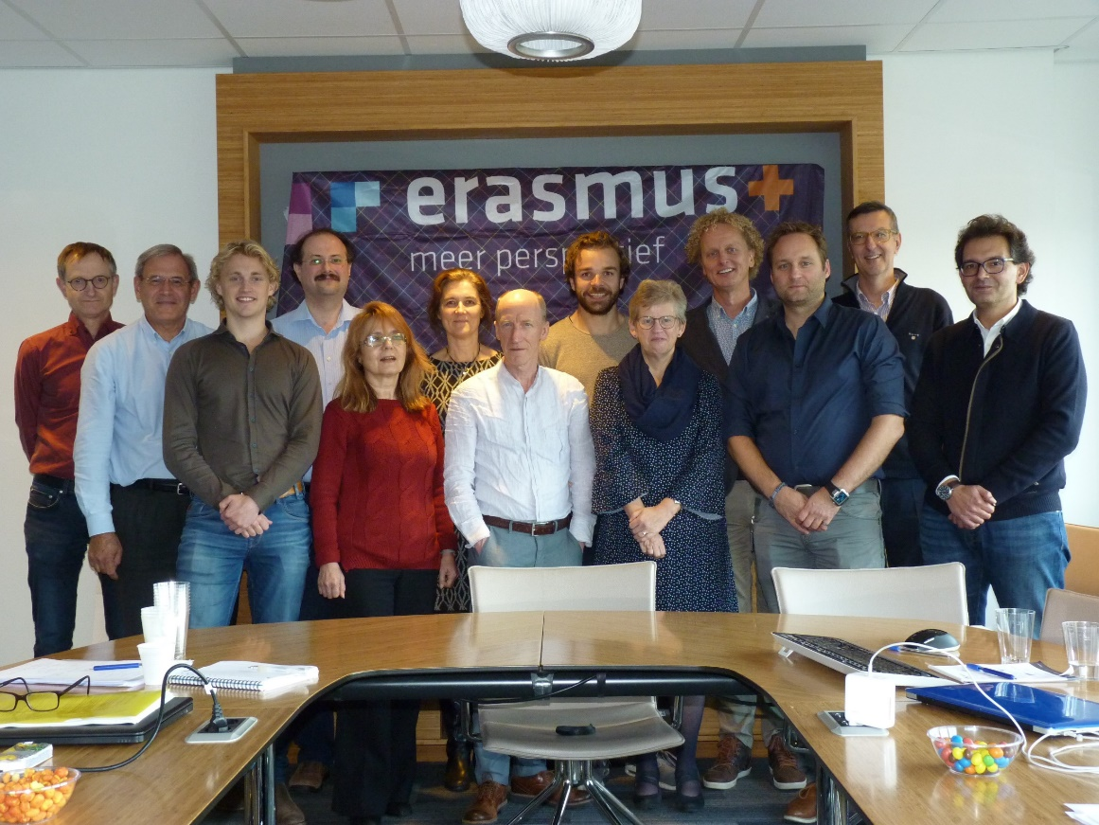



Slide 9
European Prescribing Exam (1/7)
Aims:
  Ensuring that medical students in Europe graduate with prescribing competencies for safe and effective clinical practice;
  Knowledge and skills
  Free of charge

Slide 10
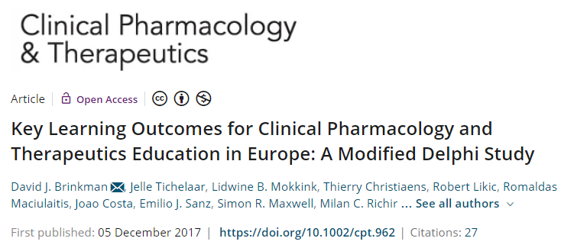
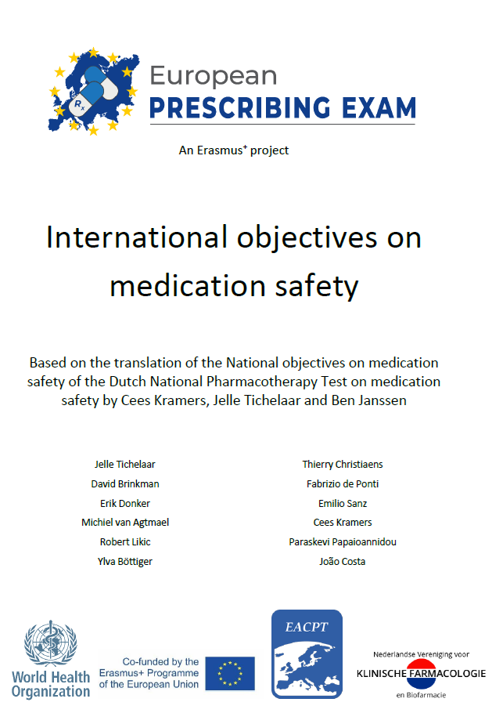
European Prescribing Exam (2/7)

Slide 11
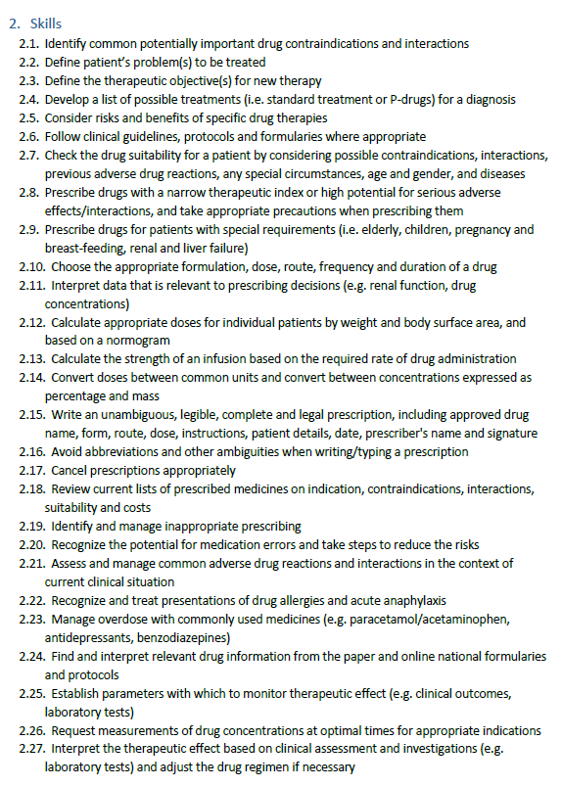
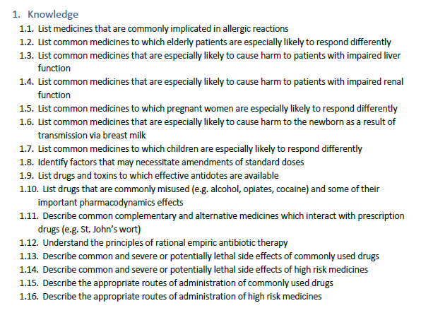
European Prescribing Exam (3/7)

Slide 12
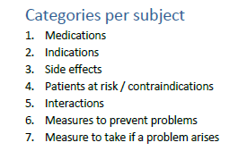
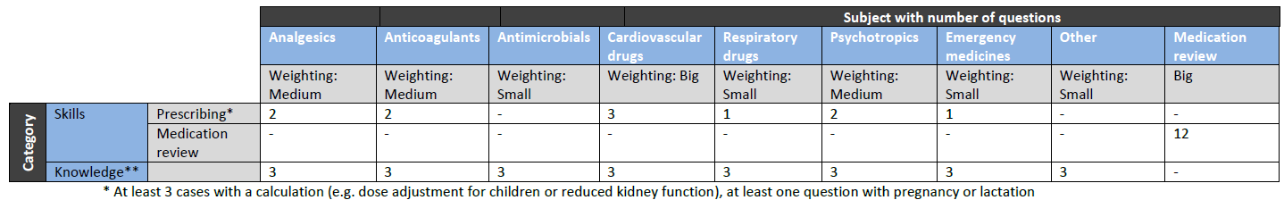
European Prescribing Exam (4/7)

Slide 13

European Prescribing Exam (5/7)
DOES
KNOWS HOW
KNOWS
SHOWS
11 prescriptions for clinical cases
12 medication reviews (multipele answer)
12 Multiple choice questions
12 Multiple choice questions

Slide 14
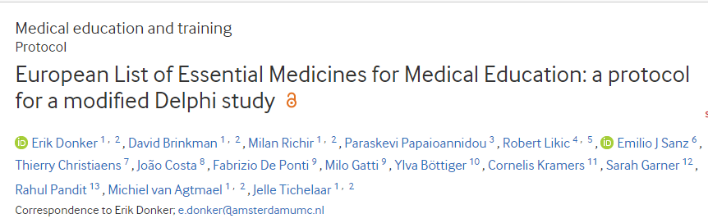
European Prescribing Exam (6/7)
At the moment 102 medicines
Available in > 80% of the countries
Specific adjustments in the exam can be made

Slide 15
European Prescribing Exam (7/7)
Penultimate of finale year medical students
Kownledge part (use of resoucers NOT allowed
Skills part (resources allowed)
2 hours

Slide 16
The platform
Accessible via https://www.prescribingeducation.eu/

Slide 17
The pilot
Can start as soon as possible
We create an university specific course in the platform
1 or more persons get(s) teacher’ right in the platform
  Open/close the exam
  Insight in the results
  NOT possible to adjust the content Exam

Slide 18
The future
EACPT congress Athens 2022
Face-to-face meeting in September/October 2022
Assessment and expert board

Slide 19
European Prescribing Exam
Preparing future medical doctors
in the European Union for
safe prescribing

